Slide 1
Data Visualization
Design Considerations
Adapted for CNIT 5700 – Fall 2018 Presented by Vetria Byrd, PhD
Assistant Professor
Computer Graphics Technology
Purdue University
Thursday, September 06, 2018
Created By: Jeffrey A. Shaffer Vice President, Unifund Adjunct Faculty, University of Cincinnati (513) 615-0001 | JeffreyShaffer@gmail.com @HighVizAbility
Notes:
Title Slide

Slide 2
Goals
By completing the course modules, students will learn:
The Shaffer 4 C’s of data visualization
Chart Junk and Data-to-Ink ratio
Keep it simple – more accurately – concise
Who’s the audience and what is the message?

Slide 3
Design Considerations

Slide 4
The Shaffer 4 C’s of Data Visualization
Clear - easily seen; sharply defined
who's the audience? what's the message?
clarity more important than aesthetics
Clean - thorough; complete; unadulterated
labels, axis, gridlines, formatting, right chart type, color choice, etc.
Concise - brief but comprehensive
not minimalist but not verbose
Captivating - to attract and hold by beauty or excellence
does it capture attention? is it interesting? does it tell the story?
Notes:
Jeff Shaffer outlines his 4 C’s of data visualization. Clear, Clean Concise and Captivating.
Clear – Who’s the audience? And what’s the message? Clarity of that message is more important than the aesthetics.
Clean – these are all of things we discusses in Module 2, dealing with gridlines, labels, use of color, etc.
Concise – brief but comprehensive
Captivating – does the visualization capture attention? Does it tell an interesting story? Or provide the user with an interesting analysis.

Slide 5
Design Considerations
Keep it Simple!
Concise
Who is the user? Know your audience.

Slide 6
The KISS Principle:
Keep it Simple, Stupid!
“It seems that perfection is reached not when there is nothing to add, but when there is nothing left to take away.”
- Antoine de Saint Exupéry
Notes:
You might have heard of the KISS principle, about keeping it simple. This quote sums up Edward Tufte’s approach to data visualization.

Slide 7
Visualization Expert:
Edward Tufte
Remove Chart Junk (unnecessary or confusing visual elements in charts and graphs)
Data-Ink Ratio (The non-erasable core of a graphic)
Data-Ink vs. Total Ink
Minimalist – Edward Tufte
Fundamentalist – Stephen Few
Notes:
Tufte coined the term “chart junk” and advocates for removing the chart chunk. But even further, he wrote about the data-to-ink ration, which compares the ink on the page associated with the data to all of the ink on the page. The concept here is to remove ink from the visualization that is not associated with the data.

Slide 8
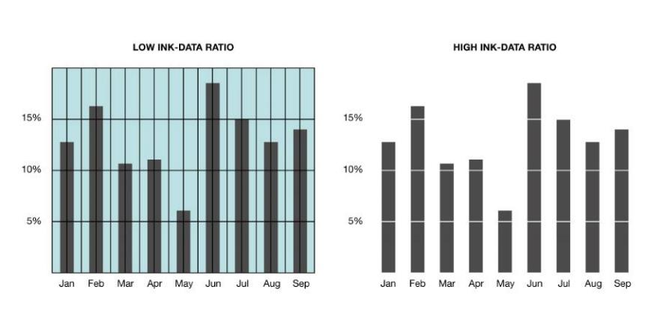
Tufte’s Five Laws of Data-Ink:
Above all else show the data.
Maximize the data-ink ratio
Erase non-data-ink.
Erase redundant data-ink.
Revise and edit.
Notes:
Tufte outlines the steps for erasing the non-data-ink in and even the redundant data-ink through an iterative process.

Slide 9
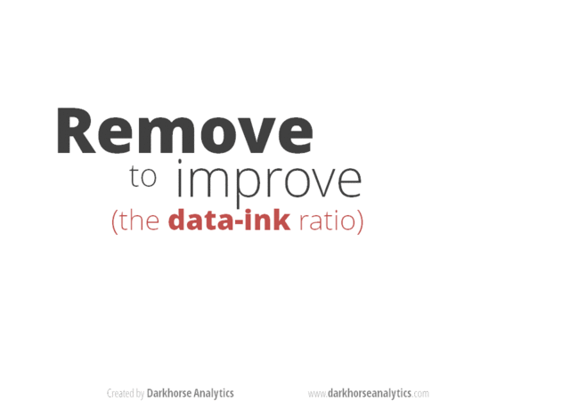
Notes:
[Animated GIF by darkhorseanalytics.com]

Slide 10
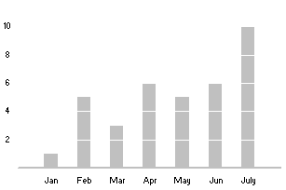
Example Bar Chart:
Notes:
This is an example bar chart with a high data-to-ink ratio. Notice there are no gridlines, no y-axis line. The chart has been stripped of the non-data-ink.

Slide 11
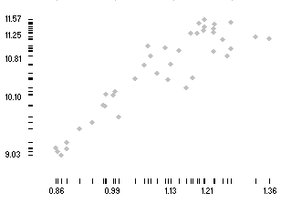
Example Scatterplot:
Notes:
Taking it to the extreme, here is another example using a scatterplot. The x and y axis have been converted from lines into strip plots of data showing the distribution of the points in the scatterplot. While the x and y axis are now data, this could certainly be confusing to a reader. If the audience is the general public, then a scatter plot may be difficult in it’s normal form. This version complicates the view even more and would require a sophisticated reader or lots of annotations around how to read and interpret this type of chart.

Slide 12
The Shaffer 4 C’s of Data Visualization
Clear - easily seen; sharply defined
who's the audience? what's the message?
clarity more important than aesthetics
Clean - thorough; complete; unadulterated
labels, axis, gridlines, formatting, right chart type, color choice, etc.
Concise - brief but comprehensive
not minimalist but not verbose
Captivating - to attract and hold by beauty or excellence
does it capture attention? is it interesting? does it tell the story?
Notes:
Compare this minimalist style that we’ve seen with the 4 C’s. Jeff used Concise, meaning brief but comprehensive. He believes that it’s ok to have redundant information in the visualization. It’s ok to double encode the data, so it’s about finding the sweet spot between minimalist and verbose.

Slide 13
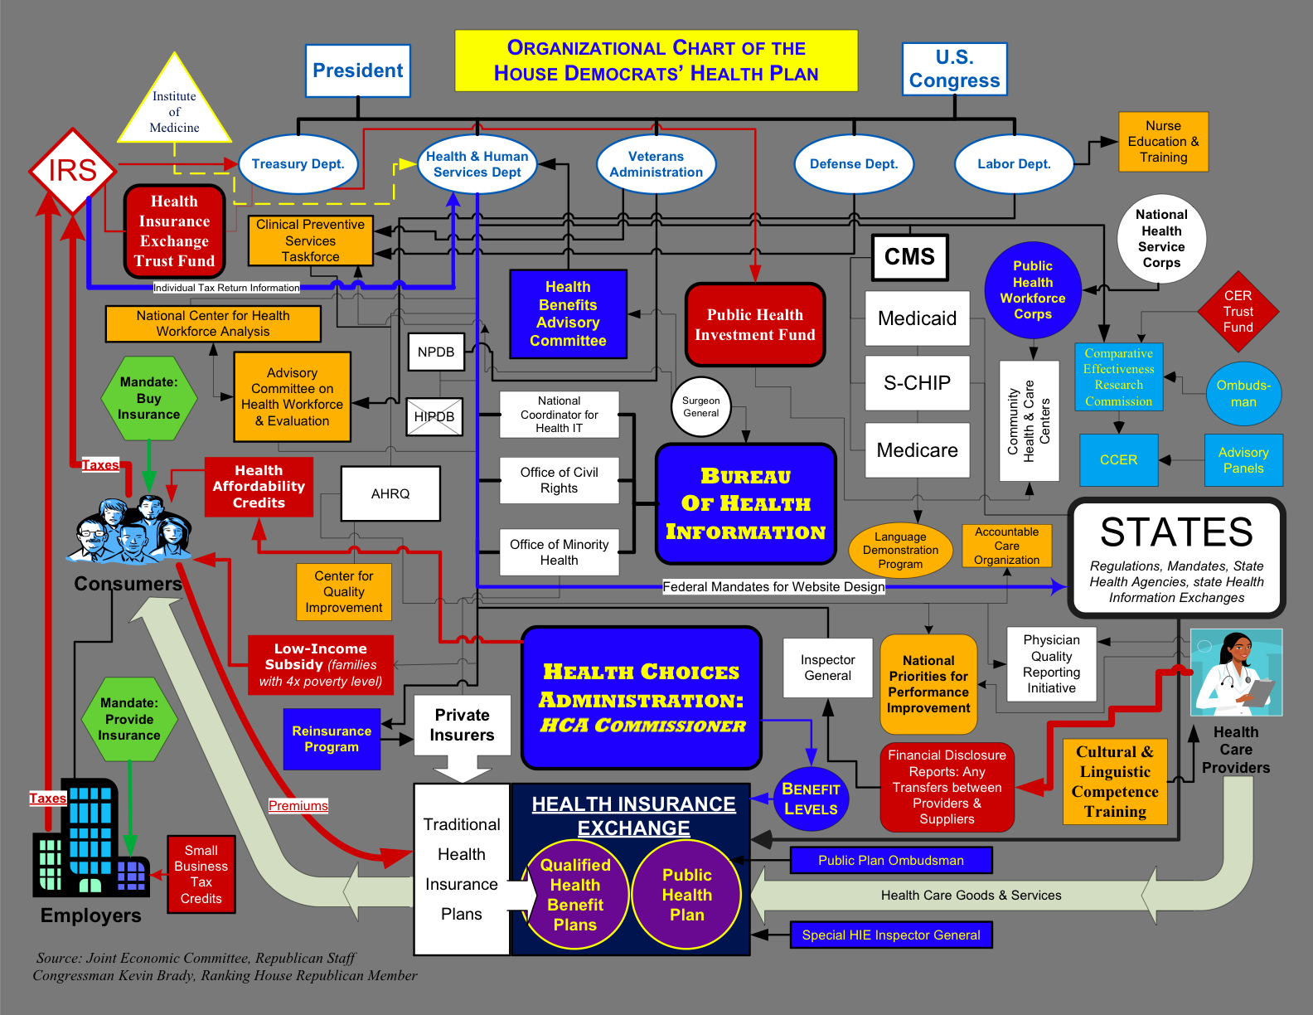
Notes:
Take a look at this one. This was presented on the House floor by the Republicans to show the complexity of the Democrats Health Care plan. They must have recognized that this wasn’t easy to read, so they added comments to it.

Slide 14
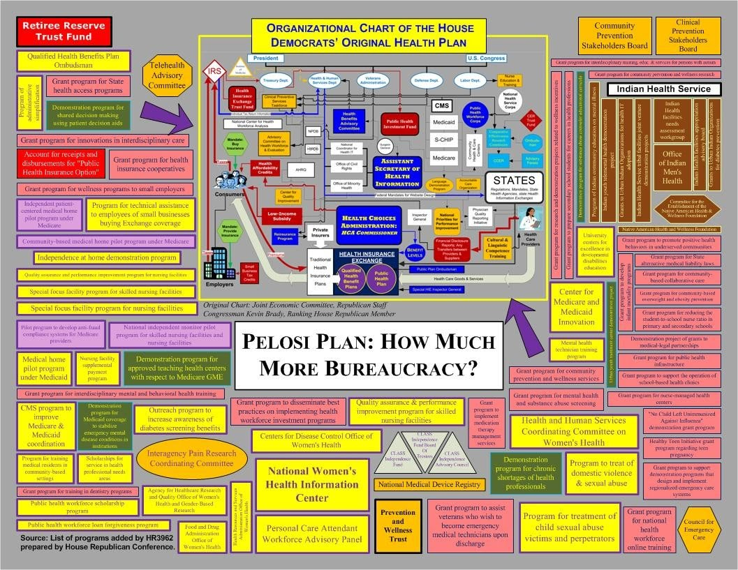
Notes:
Now it’s much easier to read. [joke]

Slide 15
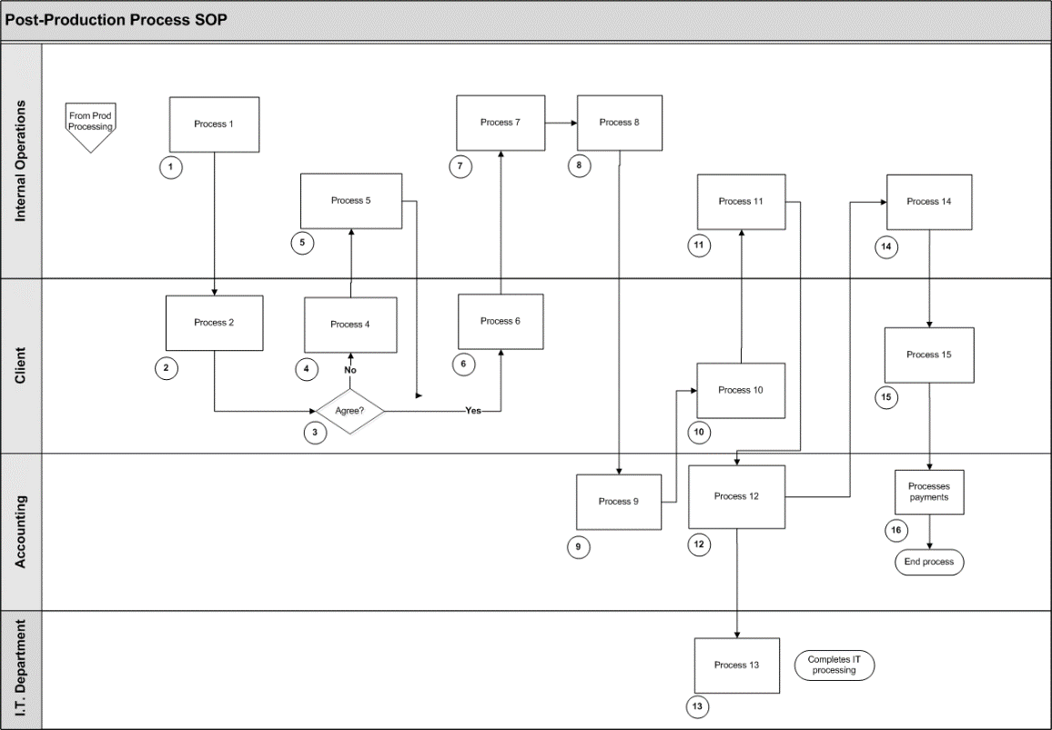
Notes:
Compare that to this swimlane diagram that organizes a process flow my department and client. Each process outlines, there is a small circle with a number connecting it to a step action table. In each step of the process we can see who is the responsible party and what the next steps are in the process. These can also be encoded with data, for example color or even small charts.

Slide 16
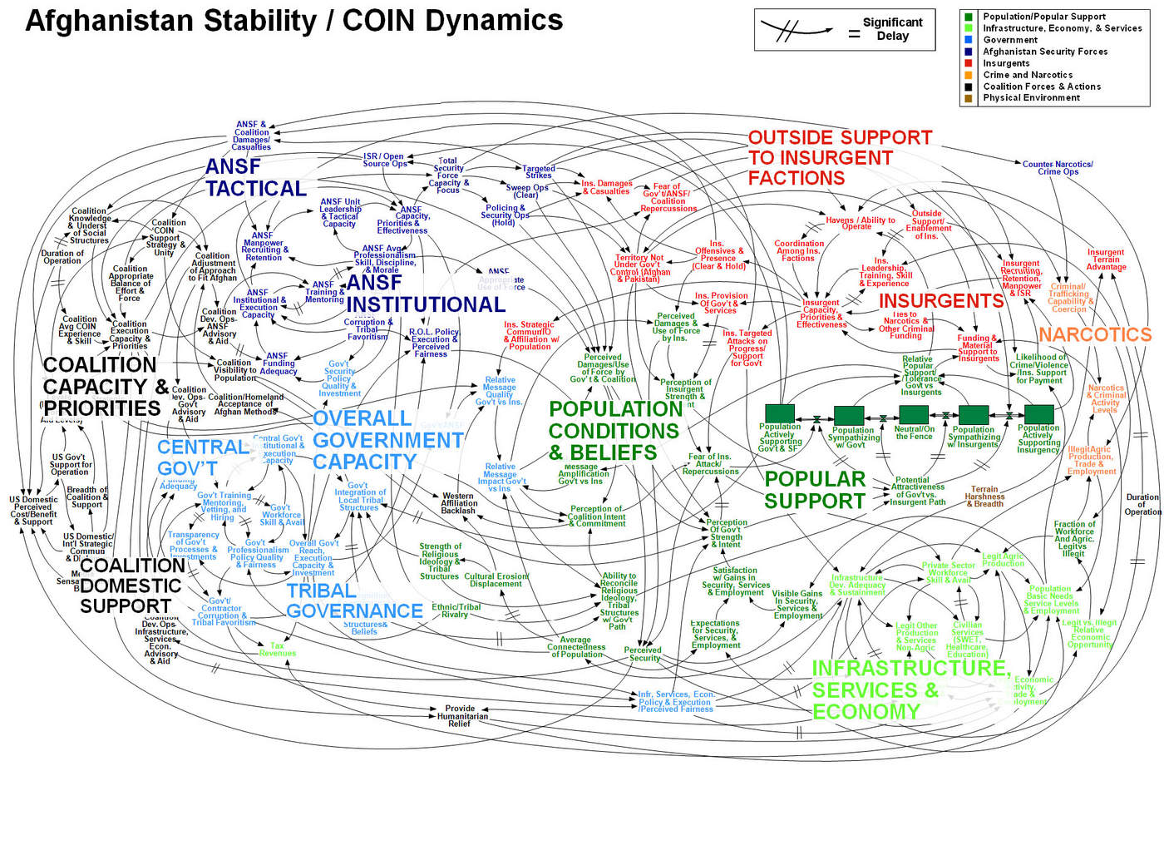
“When we understand that slide, we’ll have won the war.”
-General Stanley McChrystal
Source: https://www.theguardian.com/news/datablog/2010/apr/29/mcchrystal-afghanistan-powerpoint-slide
Notes:
Here’s the Afghanistan Stability chart. A network diagram. General McChrystal said, “When we understand that slide, we’ll have won the war.”

Slide 17
Who’s the audience and what is the message?
Notes:
Who is the audience? And what is the message?

Slide 18
Notes:
Let’s look at an example. This is food expenditure for one week of food in Germany vs. Ecuador. In Germany, the expense is $500 per week while it’s only $31.55 in Ecuador.

Slide 19
Notes:
We could trim this down even more and just label the two bars. This is pretty clear, Germany families spend, on average, much more per week on food that Ecuador. But now I’m going to show you something completely different.

Slide 20
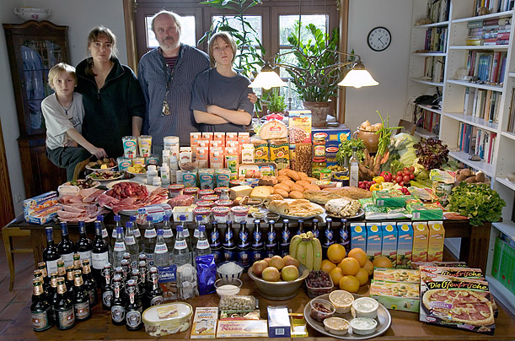
Germany: The Melander family of Bargteheide Food expenditure for one week: $500.07
Source: “Hungry Planet”
By Peter Menzel and Faith D’Aluisio
Notes:
Here’s Germany.
[let the students stare at this one for a bit]

Slide 21
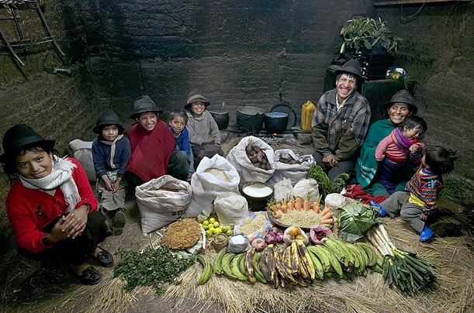
Ecuador: The Ayme family of Tingo Food expenditure for one week: $31.55
Source: “Hungry Planet”
By Peter Menzel and Faith D’Aluisio
Notes:
And this is Ecuador.
[let the students stare at this one for a bit]
Now, I could show you this data using a number of different visualization methods, but you won’t walk out of this class and say, “The professor showed me this bar chart that I just can’t get out of my mind.” But you will likely remember these images.

Slide 22
Example of data visualization for a cause
Notes:
Who is the audience? And what is the message?

Slide 23
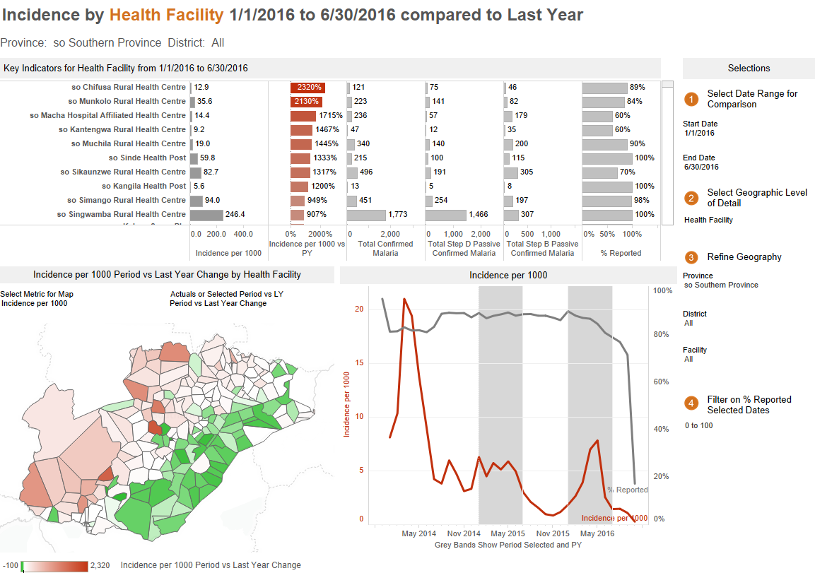
“We knew we could gain better and more insights out of that data.”
– Jeff Bernson, Director of PATH
Notes:
The “Visualize No Malaria” project is a partnership between PATH and Tableau.
Source:
https://www.geekwire.com/2016/tableau-path-fight-malaria-data-analytics-unique-seattle-based-coalition/

Slide 24
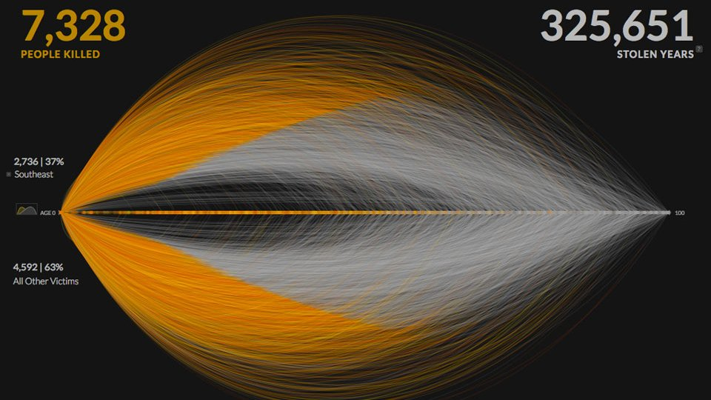
Notes:
This visualization of gun deaths in the United States was created by Periscopic.
Source:
http://guns.periscopic.com/?year=2013

Slide 25
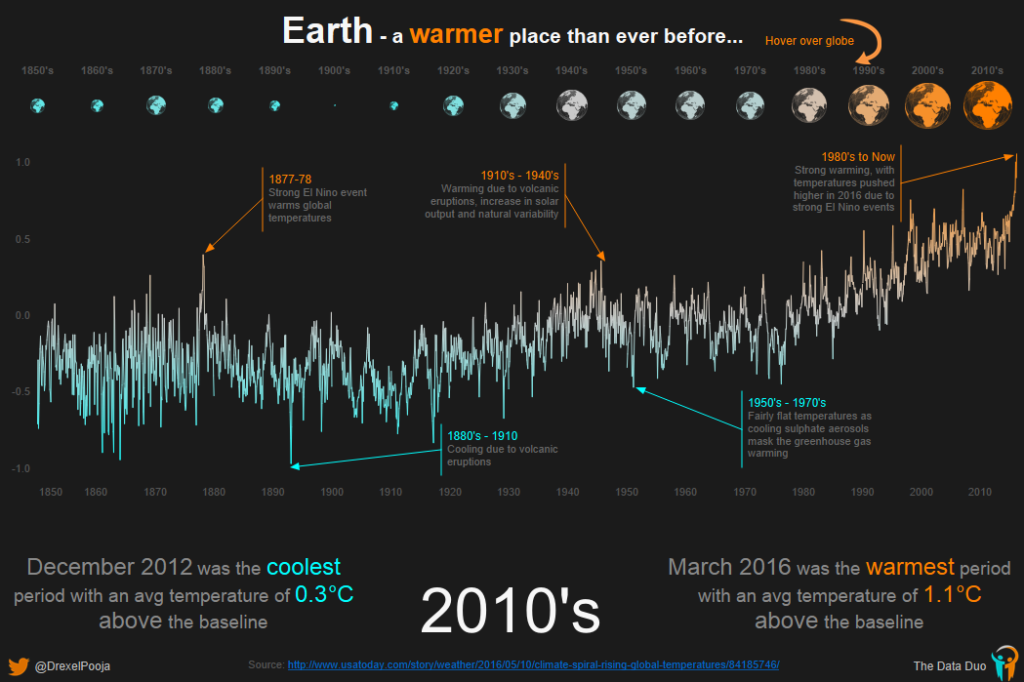
Notes:
This visualization on Global Warming done by Pooja Ghandi.
Source:
https://public.tableau.com/profile/poojagandhi#!/vizhome/GlobalWarming_1/GlobalWarming

Slide 26
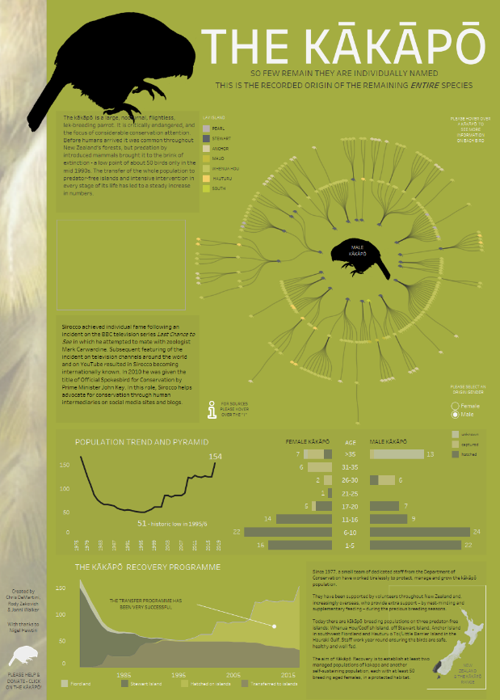
“I’m a strong believer that effective data visualization is an essential science communication tool, but too often scientists don’t think it’s important, or use tools that make good visualization difficult to achieve.”
“The ability to quickly explore our data visually is vital to ensuring that our conservation management of these endangered species is as effective as it can be. ”
- Dr. Andrew Digby
Notes:
This is a visualization of the kakapo done by Jonni Walker, Rody Zakovich and Chris DeMartini.
Source:
https://public.tableau.com/en-us/s/blog/2017/06/using-tableau-help-natural-world
Blog: “Using Tableau to Help the Natural World
https://public.tableau.com/en-us/s/blog/2017/06/using-tableau-help-natural-world

Slide 27


